Slide 1
Azure Health Checks in .NET 9
Steven Hook

Slide 2
Agenda
01
02
03
Intro to Health Checks
Demo Several Scenarios
Lessons Learned and Takeaways

Slide 3

First Impressions
Azure is randomly shutting down my app services! I need to go to YouTube and let people like, follow and subscribe to my frustration.
Reasonable Person (probably)

Slide 4
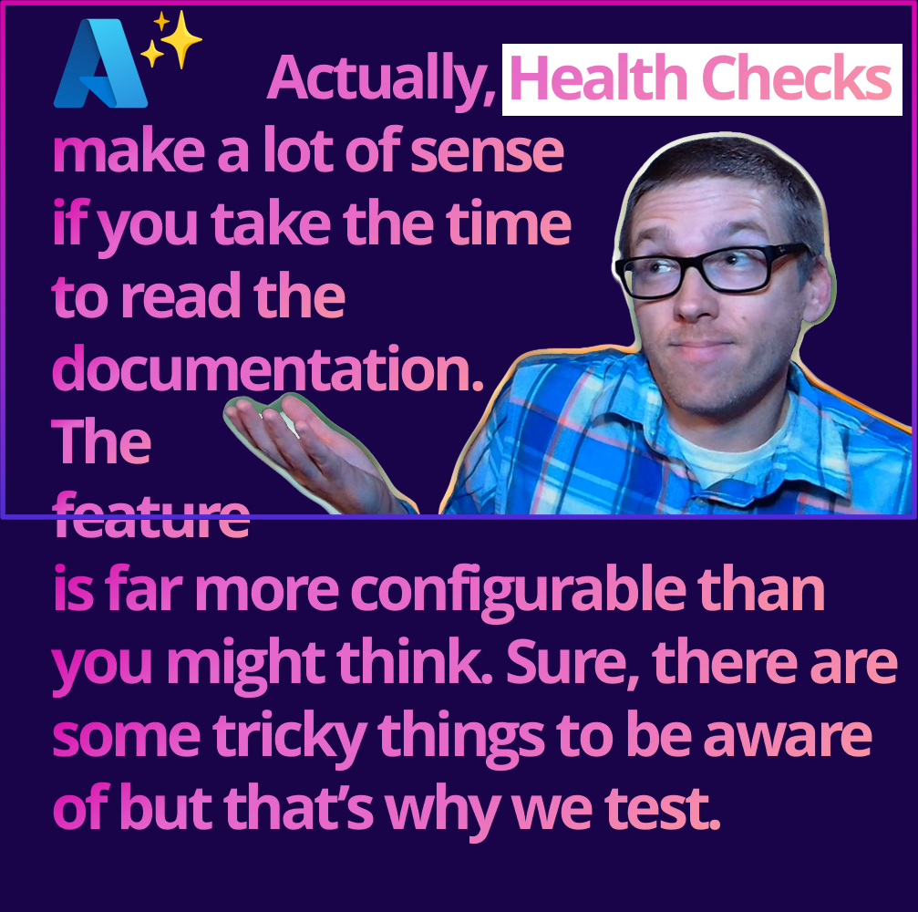
After using Health Checks in Production
Azure’s Health Check goals may differ from your expectations. Azure does a great job of explaining all the different ways you can use the feature and what happens when health checks start failing.
Steven Hook

Slide 5

Demo: Health Check Approaches
with lessons learned

Slide 6
Lessons Learned
Infrastructure
Load Balanced
New Instance
Ensure your App Service Plan is scaled to more than 1 instance to benefit from health checks
After 10 failed checks the app is removed from the load balancer
After 1 hour of failed checks the app may be re-provisioned to a new instance
Define Unhealthy
Define Degraded
Do Not Retry
Only create checks that return “Unhealthy” if you feel restarting the app will correct the problem
Return “Degraded” for checks that are not critical to the overall health of the app
Do not retry HTTP calls in a health check

Slide 7
Additional Takeaways
Essentials
Advanced Extras
Basic health checks only verify your app is ready
.NET Health Checks and Azure Health Checks are different
Use database checks if your app cannot function without that database
It is not recommended that you write your own database queries to check availability. Use a SELECT 1 query instead.
Do not health check code that is not yours. Consider returning “Degraded” for failed external checks
App Service Slots do health checks too
Monitor with App Insights, Dashboarding and Alerting
At most, one instance will be replaced per hour, with a maximum of three instances per day per App Service Plan.
Custom publishers let you control delay and period
Use predicate filtering to separate health checks
You can use dependency injection in your health checks

Slide 8

Get .NET 9
Download .NET 9 aka.ms/get-dotnet-9

Slide 9
Thank you

